Slide 1
Community Planning Outcomes Profile
Nick Cassidy – Research Manager
The ‘go to’ organisation for Local Government improvement in Scotland
Notes:
Purpose – overview, refresher, and examples of how it could be used. Hear your thoughts

Slide 2
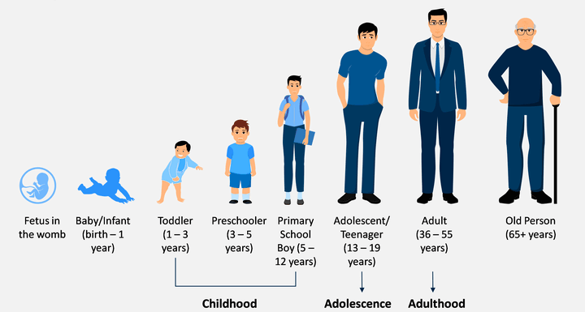
What is the profile?
A tool to help you assess if the lives of people in your community are improving
A set of core measures on important life outcomes including early years, older people, safer/stronger communities, health and wellbeing, and engagement with local communities
A consistent basis for measuring outcomes and inequalities of outcome in your area
An analysis tool
The ‘go to’ organisation for Local Government improvement in Scotland
Notes:
-Core measures cover whole life cycle and all communities and community groups
-A consistent data set
-Does a lot of advanced analysis for you

Slide 3
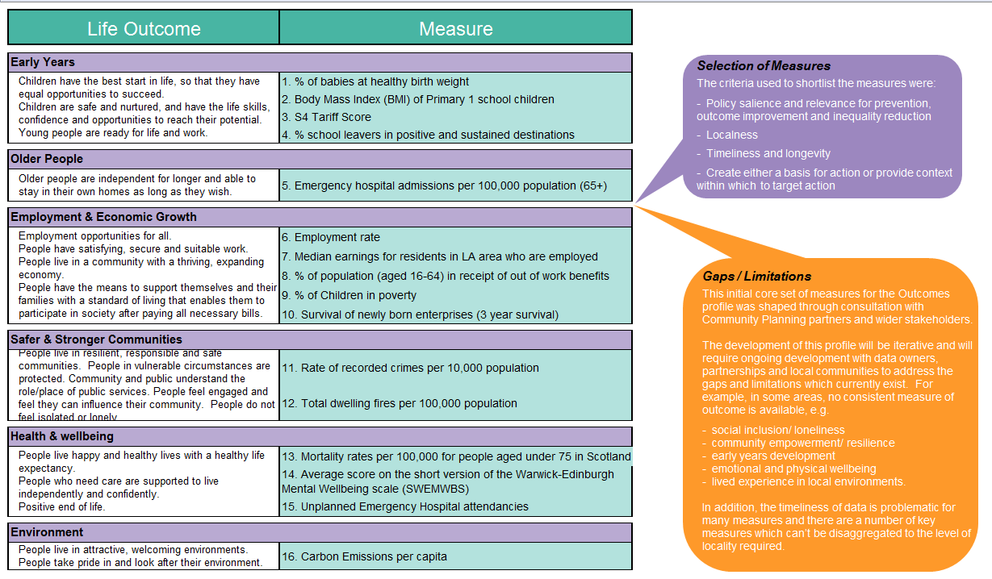
Notes:
Idea is to cover the whole life course and range of outcomes.
Measures were developed with CP Partners – criteria for inclusion
This is the original set and have been amended over the years – we know there are gaps inc. data lag.
As much as possible cover small areas, not just full CPP

Slide 4

What does the profile tell you?
At a glance and in-depth analysis on:
The overall pattern of outcomes in your area and whether people's lives are improving
Whether inequality is increasing or decreasing over time
Which communities are faring well or not well for your areas and for similar communities across Scotland
Identify similar areas elsewhere in Scotland, creating opportunities for learning
The ‘go to’ organisation for Local Government improvement in Scotland
Notes:
Both at a glance information and in depth analysis
Focus on change over time
Good/bad performance
Uniquely we have the comparison with similar areas – about learning from others.

Slide 5
How can the profile be used?
To support decision-making by:
Stimulating discussion amongst CP boards, partners and local communities
Increasing the amount of intelligence available about an area
Complementing professional judgement and local knowledge
Inform the development of Local Outcomes Improvement Plans
The ‘go to’ organisation for Local Government improvement in Scotland

Slide 6





How is this approach different?
Focus: CPPs
It brings together measures of outcomes and inequality for all 32 CPPs within one profile - and shows how they change over time
It considers outcomes 'in the round' as well as individually, encouraging a focus on vulnerable communities where negative outcomes are clustered
It enables partnerships to compare outcomes for their local communities against similar communities across Scotland
The ‘go to’ organisation for Local Government improvement in Scotland
Notes:
Lots of other data sources and tools
CPOP is focused on community planning partnerships and what they need
-Selecting, cleaning, presenting key data
-Change over time – measure improvement – including into the future
-Holistic approach (understand performance across multiple indicators), but allows focus on specific areas
-Typology – income, rurality, population groups

Slide 7
Case Studies
The ‘go to’ organisation for Local Government improvement in Scotland
Notes:
How and where used

Slide 8
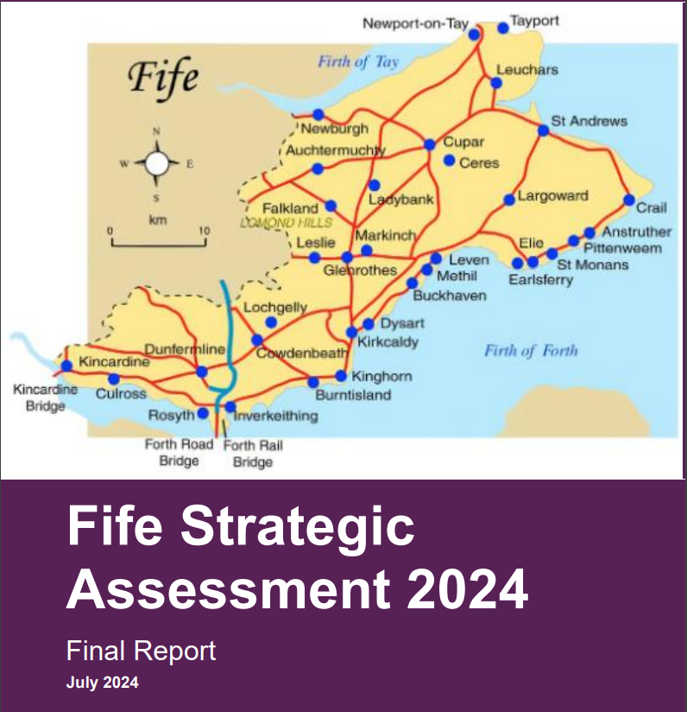
Case Studies – Fife Strategic Assessment
Fife regularly use CPOP to review and refresh their local strategic assessments
Data/analysis from CPOP
Includes comparisons with similar areas
Use the strategic assessment to identify issues and challenges facing the area
The ‘go to’ organisation for Local Government improvement in Scotland
Notes:
Use regularly for strategic assessment
Draw on data and analysis – esp. comparison with similar areas
Strat Assessments used for prioritisation

Slide 9
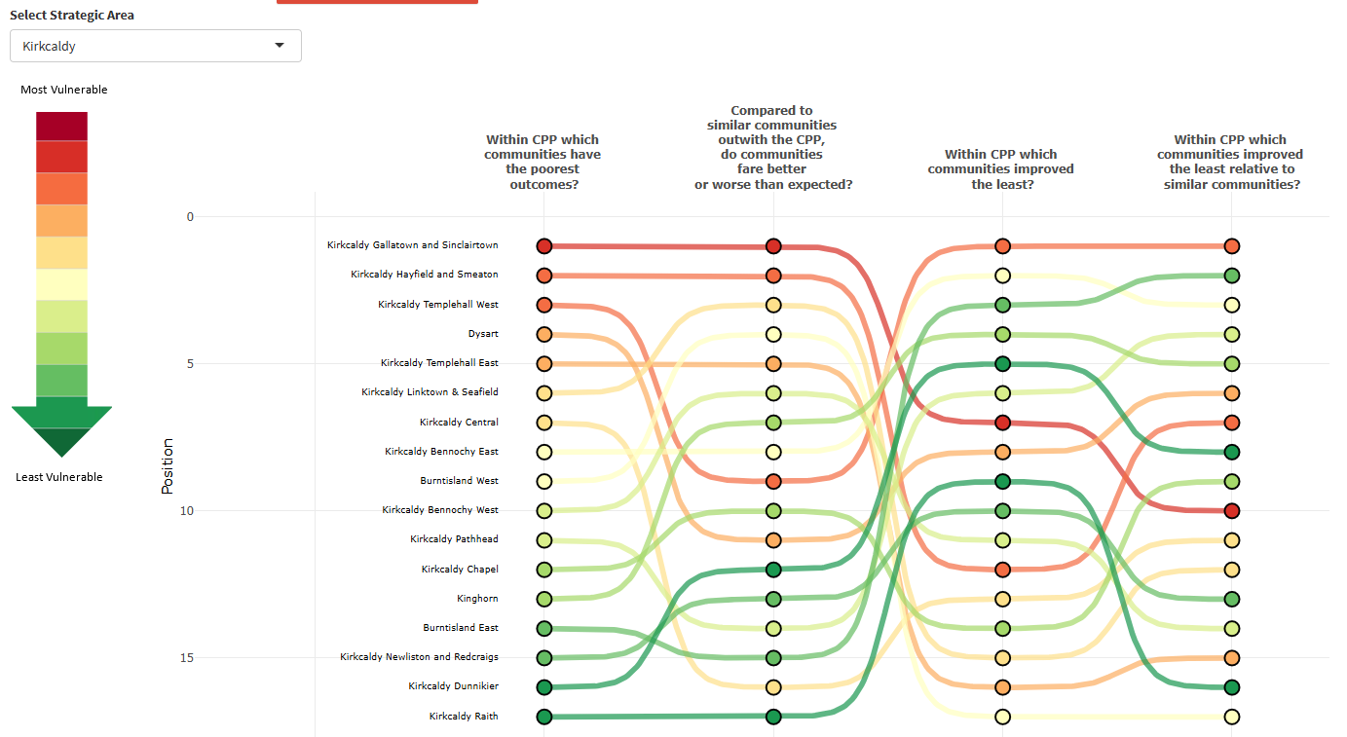
Case Studies – Fife Strategic Assessment
The ‘go to’ organisation for Local Government improvement in Scotland
Notes:
To help with his – Fife has their own custom setting in the dashboard , which allows them to compare areas within each strategic area

Slide 10
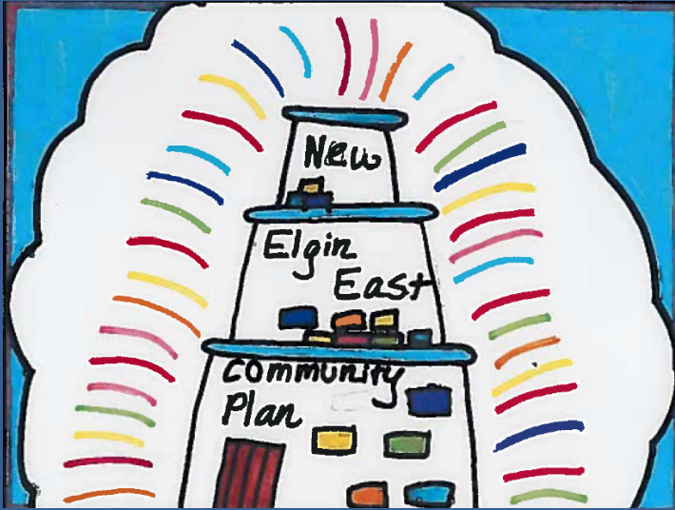
Case Studies – Moray Locality Profiling
Moray use for prioritisation
Identify two most vulnerable areas
CPOP data used together with other sources
Buckie Central East and New Elgin East
Developed Locality Plans to tackle the primary issues in each
Ongoing review – CPOP focus on time series
The ‘go to’ organisation for Local Government improvement in Scotland
Notes:
-Prioritise
-data from other sources to identify the 2 most vulnerable communities
-issues including reducing child poverty, improving educational attainment, and improving employment opportunities in better paid jobs
-Ongoing review

Slide 11
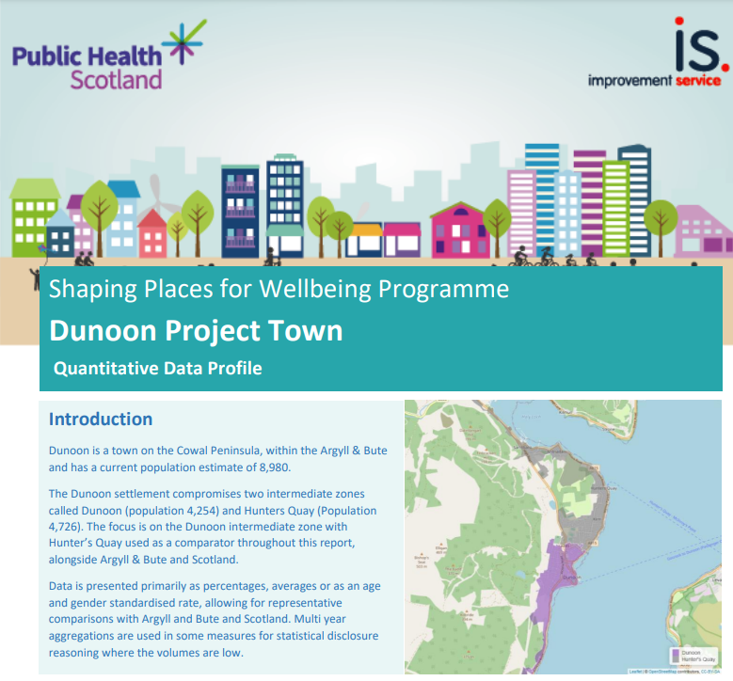
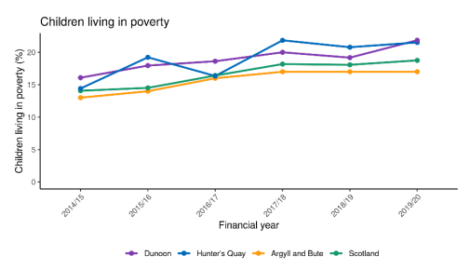
Case Studies – Shaping Places for Wellbeing
Shaping Places for Wellbeing incorporated the data and analysis into their quantitative review of towns.
The ‘go to’ organisation for Local Government improvement in Scotland
Notes:
Shaping Places for Wellbeing – national programme between PHS and IS – 7 towns to embed place based approaches
First step was quantitative profiling
Dunoon - https://www.improvementservice.org.uk/__data/assets/pdf_file/0022/48307/Shaping-Places-for-Wellbeing-Dunoon-Profile.pdf
-Useful as a good data source
-Wider cohort of PHS colleagues interested in some of the more advanced analysis

Slide 12
CPOP Demo
The ‘go to’ organisation for Local Government improvement in Scotland
Notes:
The CPOP has a range of data both at a CPP level and at a more granular intermediate geography zone and data zone level. One of the key features of the tool is the ability to make comparisons between areas, comparisons over time and to look both at outcomes and progress with these outcomes across the full range of indicators.
This demo will provide a bit of insight into how the tool can be used to understand your CPP’s performance, explore areas for improvement, and identify other local areas that you may be able to learn from.
First select your CPP area to explore the tool.

